Slide 1
SUDOKU GAME
Zilin Li

Slide 2
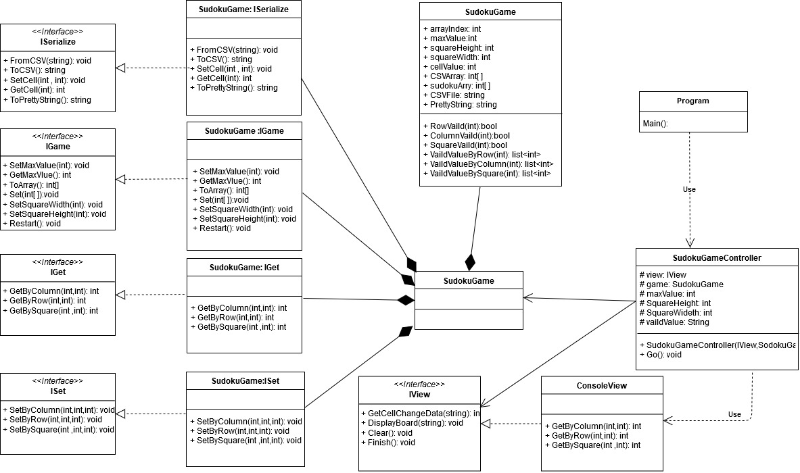
DESIGN OF THE GAME: Class Diagram
+ GetSquareWidth():int
+ GetSquareHeight():int

Slide 3
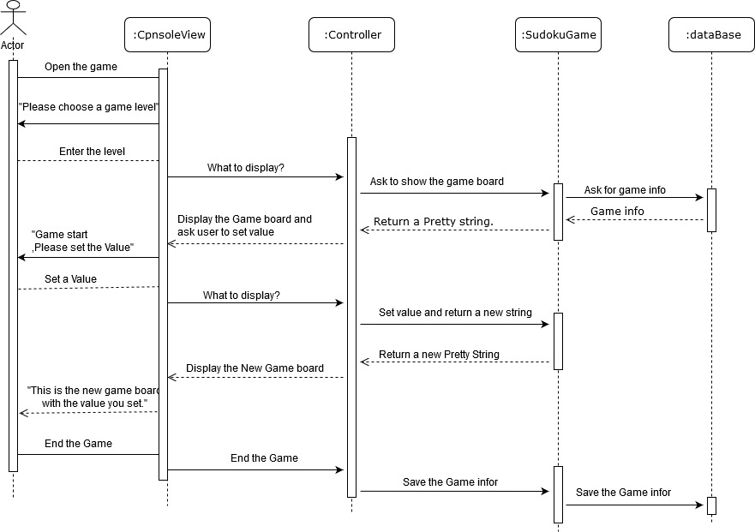
DESIGN OF THE GAME: Sequence Diagram of Sudoku Game:

Slide 4
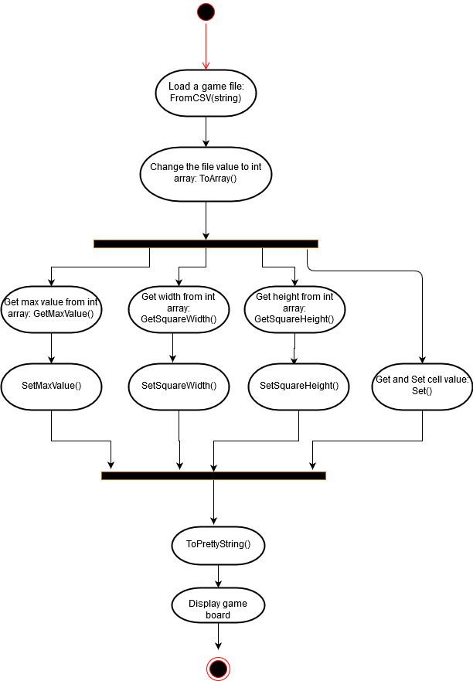
These features make the game work: MUST HAVE
Get the game data from a CSV file:
FromCSV(string): Get game information from CSV file.
ToArray(): Change CSVFile string to int array.
Set the data to the game:
GetMaxValue(): Get the maxvalue from CSVFile array.
GetSquareWidth(): Get the width from CSVFile array.
GetSquareHeight(): Get the height from CSVFile array.
SetMaxValue(int): Set max value to model.
SetSquareWidth(int): Set width to model.
SetSquareHeight(int): Set height to model.
Set(int[]): Get all the cell value from CSVFile array,and set it to model.
Display the game board:
ToPrettyString(): Use to output the game board.
Allow users to enter values:
SetCell(int,int): Use to set a value by cell index.
Allow users to end the game:
Restart()
ToCSV(): Use to save the game as a CSV file format.
Activity Diagram
This Diagram show how the program load and set the game information

Slide 5
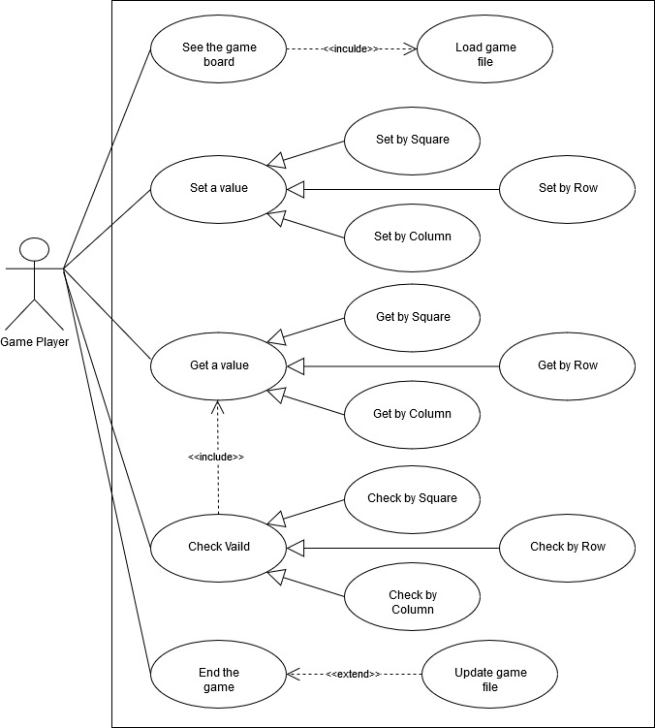
These features make the game runs better: SHOULD HAVE
Set a cell value by different way:
SetByColumn(int, int, int)
SetByRow(int ,int, int)
SetBySquare(int ,int, int)
USE CASE
Get a cell value by different way:
GetByColumn(int, int)
GetByRow(int ,int)
GetBySquare(int ,int)
GetByCell(int)
Check if a specific area is vaild:
RowVaild(int)
ColumnVaild(int)
SquareVaild(int)

Slide 6
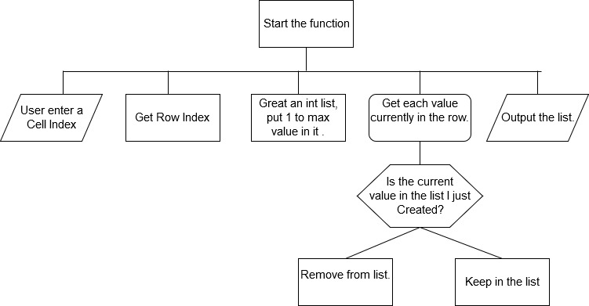
These features make the game have more fun: COULD HAVE
Provide game hints to users
VaildValueByRow(int)
VaildValueByColumn(int)
VaildValueBySquare(int)
VaildValueByCell(int)
Structure Diagram for VaileValueByRow function.

Slide 7
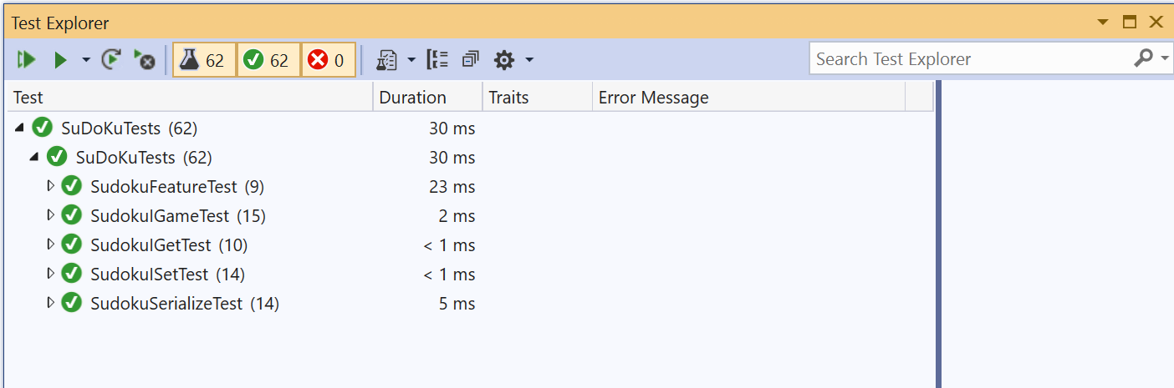
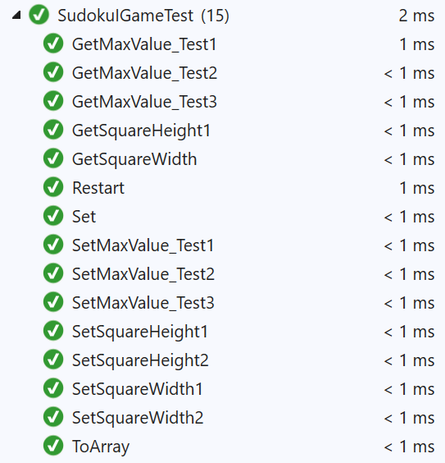
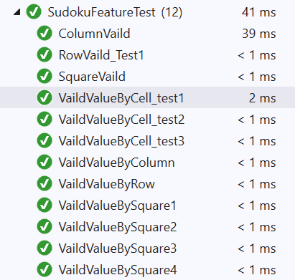
Unit Test of the Sudoku Game

Slide 8
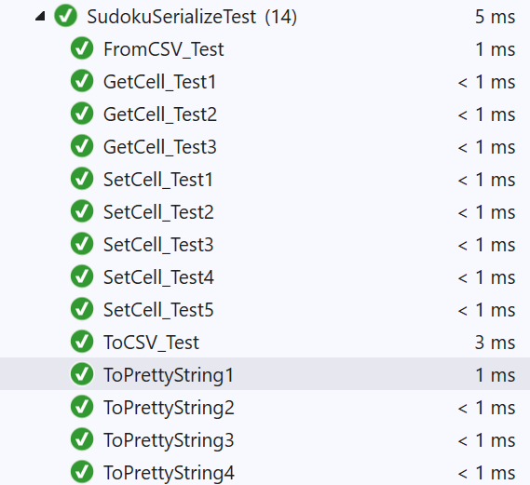
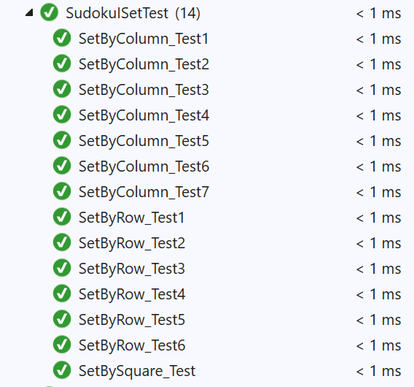
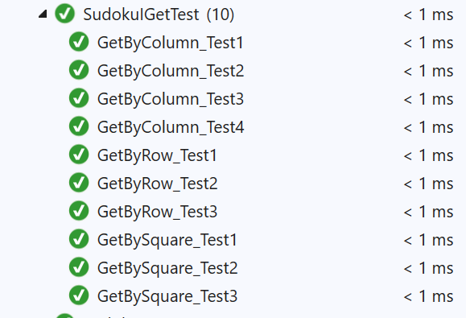
Unit Test of the Sudoku Game

Slide 9
Thank You!

